Slide 1


Module 1: Introduction to Computer Programming
Introduction to Python Programming

Slide 2
Content
What is Python?
Why Learn Python?
History of Python
Why Python is Used for ML?
Python Environment
IDE
Installing Python on Windows, Mac and Linux OS
Writing your First Program in Python

Slide 3
What is Python?
Python is a general purpose, high level and powerful dynamic programming language.
Python is an Object Oriented Programming language i.e. it is based on classes and objects where each object can
communicate with other by exchanging messages and processing data.
Its design philosophy is based on the importance of readability and simplicity
clean and easy to learn syntax
It is Free and Open Source which means that it is free for download and the source code is freely available and open for
modification and reuse.
It compiles and runs on a wide variety of UNIX, Windows, MacOS, and various other platforms.

Slide 4
Why Learn Python?
1
2
3
Great Data visualization
Varied plots such as boxplots, histograms, barplots, etc are available and are high in quality and self- explanatory.
Flexible
It is very easy to write code enhancements, develop packages, develop apps, write your own functions and distribute your own software
Embeddable
Python allows to add scripting capabilities to the code in other languages.
4
5
Machine Learning
Easy to understand and use machine learning libraries.
Speedy
It offers fast and effective support to the developers and programmers, it brings down the development time and cost.

Slide 5
History of Python
1980
Designed by Guido Van Rossum at Centrum Wiskunde & Informatica (CWI) in
the Netherlands.
1
2
1990
Derived from the television series Monty Python's Flying Circus.
1991
First release of Python with version 0.9.0.
3
4
1994
Python version 1.0 is released
2000
Python version 2.0 is released
5
6
2008
Python version 3.0 is released
2020
Python version 3.8.3 is released
7
As of July 2025, the latest stable version of Python is Python 3.12.3, released in May 2025.

Slide 6
Why Python is Used for ML?
Python and R are among the most popular programming languages for Machine Learning and are often found opposite to each other in the room of debate on the fact that which one is more valuable. However, both the languages have their specialised features which makes them unique.
But what is making Python very popular?
Syntax simplicity: its simple and elegant syntax is easy to get along yet being so much powerful at the same time.
Operability on different environments: it is easy for programmers to write maintainable, large scale robust code
Libraries: Python provides data scientists with a set of powerful and efficient libraries like Scikit, Numpy, Pandas, Scipy that assist data analysis and large scale statistical computing.

Slide 7
Python Environment
Python has a rich and powerful external library support which comprises of external modules and packages. It has large set of extremely useful built-in functions.
Automatic memory management system which uses a mix of reference counting and a cycle detecting garbage collector.
Now, how does reference counting works?
Every Python object has a reference counter. An extra counter is kept along with each object that is created. Anytime a reference is copied counter is incremented, and anytime a reference goes out of scope, or is reset, counter is decremented.
What does the Cycle Detection Garbage collector do?
It detects the objects which are no longer referenced and recycles the unused memory by freeing up the memory from those objects.
Python commands are case sensitive.

Slide 8
IDE
Integrated Development Environment(IDE) is a software which provides programmers with an interface combined with all the tools at hand
Selection of the right IDE influences the productivity and effectiveness of Python programming
There are many IDE's for Python (for data science) such as Spyder (Scientific PYthon Development EnviRonment), Jupyter Notebook and VS Code (actually a code editor)
Most recommended and widely used among these are VSCode and Jupyter Notebook.

Slide 9
Installing Python on Windows, Mac and Linux OS
Python is a high level, interpreted language that usually comes pre-installed on all computers.
Because Python is widely used for various purposes, it has a lot of packages available which are all compatible with different versions of the language. This can be painful for a beginner to manage, right at the introduction to his or her journey.
The easiest way of installing Python for data science is to use the Data Science Package Manager, Anaconda. It is the simplest way to install Python with all the libraries you need, it manages all package compatibility issues and doesn't interfere with the required system libraries.
If you still wish to download python separately, you can go to http://www.python.org and select the version that is suitable for your Operating system and hardware. Be careful to select the latest stable version.

Slide 10
Anaconda & the Conda Distribution
conda install <packagename>.
The Conda distribution is an open data science platform powered by Python. It consists of two package managers –
Anaconda & Miniconda.
Anaconda package list includes:
  easy installation of Python(2.7.12, 3.4.5, 3.5.2 and 3.6)
  updates of over 100 pre-built and tested scientific and analytic Python packages
  over 620 more packages available via a simple command:
  open source development environments such as Jupyter/IPython and Spyder and is supported by Sublime Text 2 and PyCharm.
However, Anaconda takes up a lot of disk space which is why Miniconda comes in as an alternative – it includes only conda and Python, where all the other packages can be installed separately as per your needs.

Slide 11
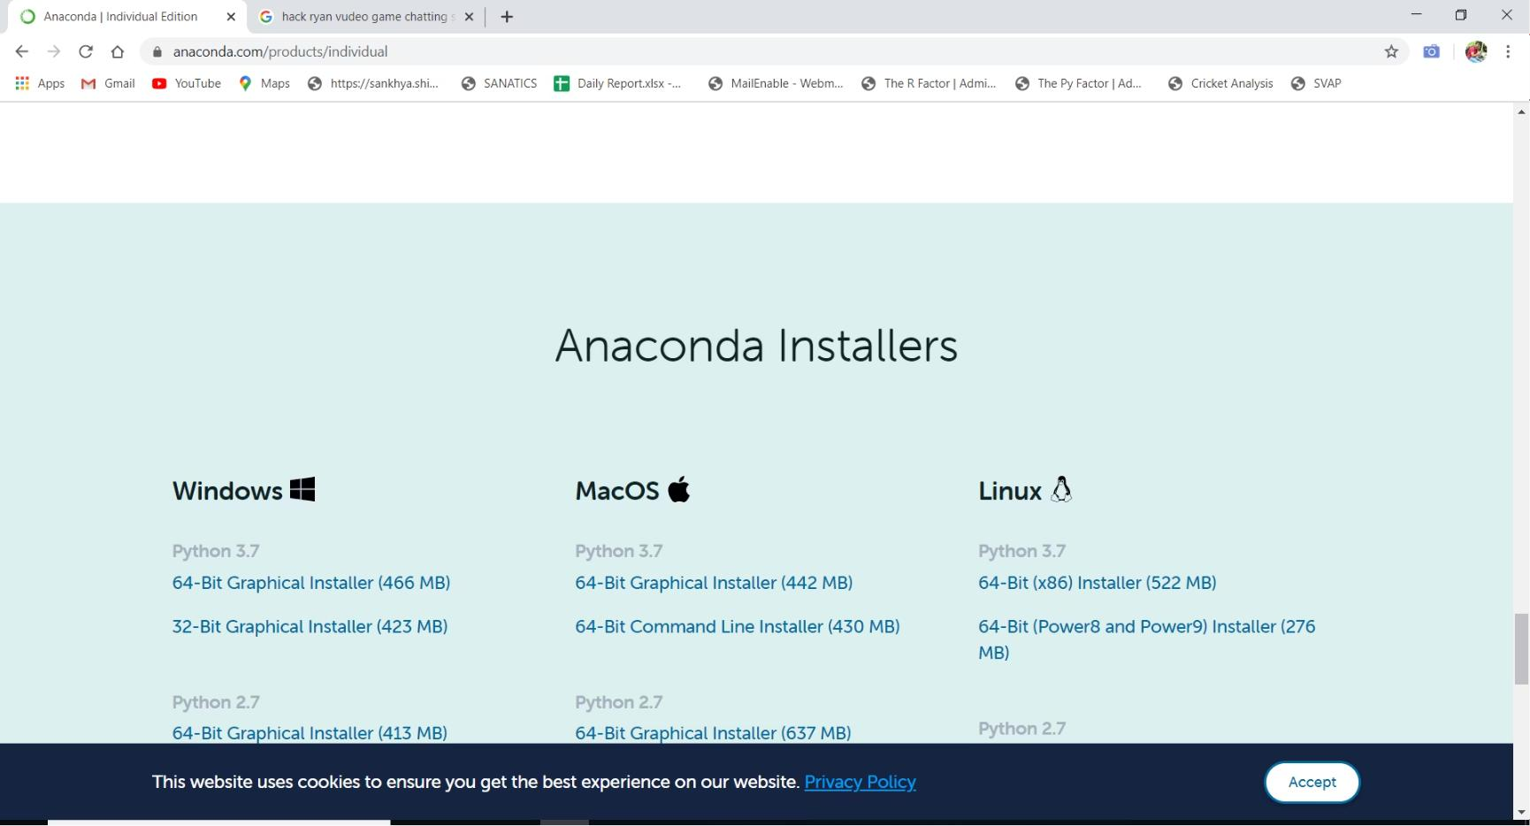

Installing Anaconda (Simulation)
Steps (for all OS):
Go to https://www.anaconda.com/products/individual to download the installer. Click on the installer link according to your system. It will take a while to download the .exe file.
Once you have downloaded the file, open it and follow the instructions of the installer.
Note: The interface of this site might change, but installer can be downloaded from this link.

Slide 12
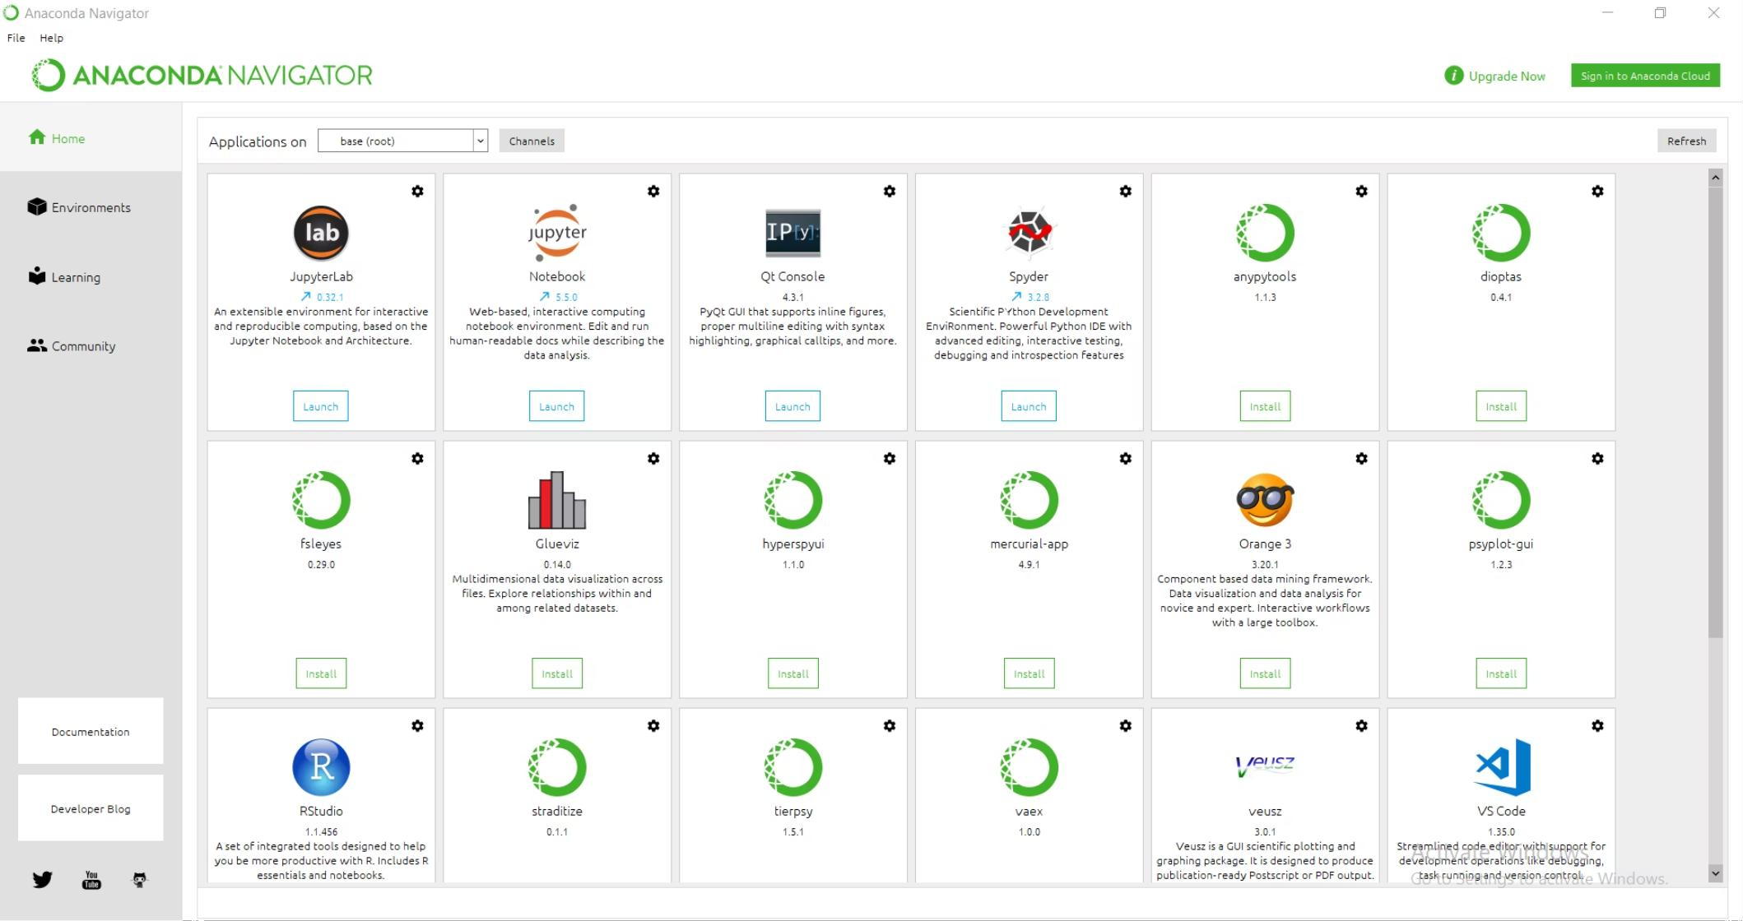
Installing Anaconda (Simulation)
After completing the installation process, launch Anaconda Navigator. The screen will appear as shown below.
It provides Various python IDE(s) like Jupyter, Qt Console, Spyder etc. You can install the necessary Python IDE suitable for your application and system.

Slide 13
Writing your First Program in Python
Creation of object (an object can store values and further can be used in multiple tasks):
# Create an object x and assign a value 20
x=20
x
20
The '=' operator is used to assign the values to an object.
Execute or run the command using the enter key in python console and F9 key in Editor. You can run a single command, bunch of commands by highlighting those, or the entire file at once.
Comments are used to describe the code and can be added by preceding all comments with the # symbol.

Slide 14
Writing your First Program in Python
Create another object and perform some mathematical calculations using both the objects
# Create an object y and assign a value 15
y=15
y
15
# Add x and y
x+y
35
# Multiply x with y
x*y
300
'+', and '-' are Arithmetic operators. There are more such operators for which we have a dedicated session at a later stage.

Slide 15
Writing your First Program in Python
We can use print command to join multiple words, strings(sequence of characters), numbers.
To join multiple items to form a single sentence, separate the items to be printed with comma ( , ) operator.
print ("This is", "session no.", 3)
This is session no. 3
Different operators and formatting options that can be used with print command are:
,
To print multiple strings in a line
+
To concatenate two strings into a single string
%
To concatenate strings and integers

Slide 16
Writing your First Program in Python
How to print a message?
print ("Welcome to Ask Analytics")
Welcome to Ask Analytics
print() is a python command to print a text message which must be enclosed in quotes.
Print numbers:
print (55)
55
print (4*5)
20

Slide 17




THANK YOU!

